Slide 1


Introduction to JSP

Slide 2
Agenda
Web Application
Servlet
JSP
JSP Lifecycle
Tag
Custom Tag

Slide 3


Web Application
Web Request & Response
HTTP/HTTPS Protocol
CS
http/https
WS
Request
Response

Slide 4
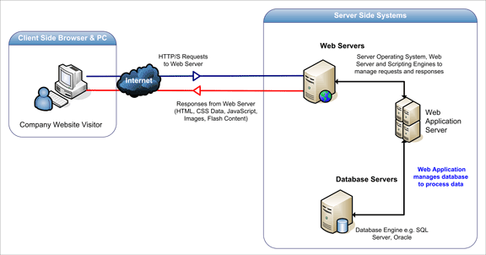
Web Application
How do web application work?

Slide 5
Servlet

Slide 6
Servlet
What is Servlet?
A java programming language class to extend and enhance web servers
Run on web server and build web page
Server side components
Provide dynamic content
Process and/or store the data
Manage information state

Slide 7
Servlet
Specification
Tomcat | Servlet / JSP | JDK
3.3.x | 2.2 / 1.1 | 1.1
4.1.x | 2.3 / 1.2 | 1.3
5.5.x | 2.4 / 2.0 | 1.4
6.0.x | 2.5 / 2.1 | 1.5
7.0.x | 3.0 / 2.2 | 1.6
8.0.x | 3.1 / 2.3 | 1.7
9.0.x | 4.0 / 2.4 | 1.8
Glassfish | Servlet / JSP
2.1.x | 2.5 / 2.1
3.0.x | 3.0 / 2.2
3.1.x | 3.0 / 2.2
4.0.x | 3.1 / 2.3

Slide 8
Servlet
Basic Servlet Structure
import java.io.*;
import javax.servlet.*;
import javax.servlet.http.*;
public class SomeServlet extends HttpServlet {
public void doGet(HttpServletRequest request, HttpServletResponse response) throws ServletException, IOException {
// Use "request" to read incoming HTTP headers (cookies)
// and HTML form data (data the user entered and submitted)
// Use "response" to specify the HTTP response and headers
PrintWriter out = response.getWriter();
// Use "out" to send content to browser
}
}

Slide 9
Servlet
Servlet Generate Plain Text
import java.io.*;
import javax.servlet.*;
import javax.servlet.http.*;
public class HelloWorld extends HttpServlet {
public void doGet(HttpServletRequest request,
HttpServletResponse response)
throws ServletException, IOException {
PrintWriter out = response.getWriter();
out.println("Hello World");
}
}

Slide 10
Servlet
Servlet Generate HTML
import java.io.*;
import javax.servlet.*;
import javax.servlet.http.*;
public class HelloServlet extends HttpServlet {
public void service(HttpServletRequest request, HttpServletResponse response) throws ServletException, IOException {
PrintWriter out = response.getWriter();
out.println("<HTML>");
out.println("<TITLE>Hello Servlet</TITLE>");
out.println("<HEAD></HEAD>");
out.println("<BODY>Hello World</BODY>");
out.println("</HTML>");
out.flush();
out.close();
}
}

Slide 11
Servlet
Install Servlet
download & install tomcat
create project under tomcat webapps
ex. C:\apache-tomcat-9.0.71\webapps\JSP
create WEB-INF folder under project
ex. C:\apache-tomcat-9.0.71\webapps\JSP\WEB-INF
create classes & lib folder

Slide 12
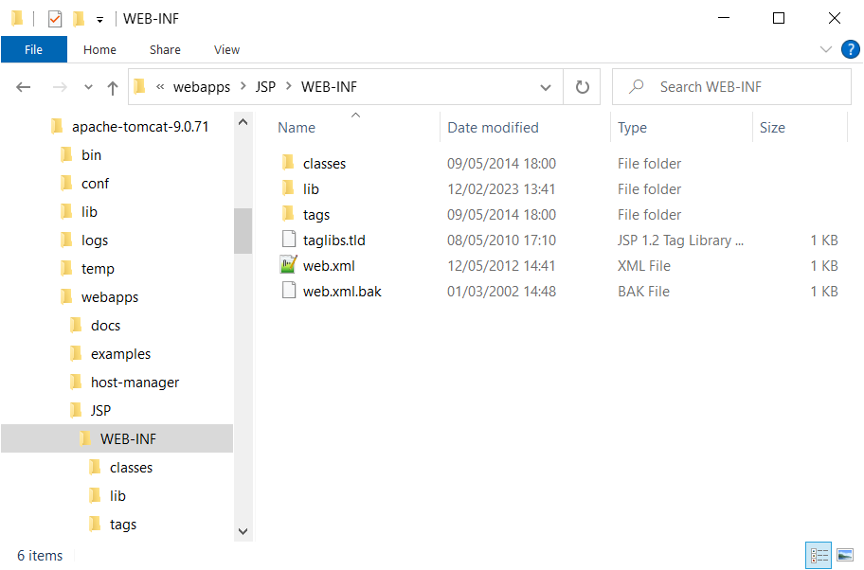
Servlet
Install Servlet

Slide 13
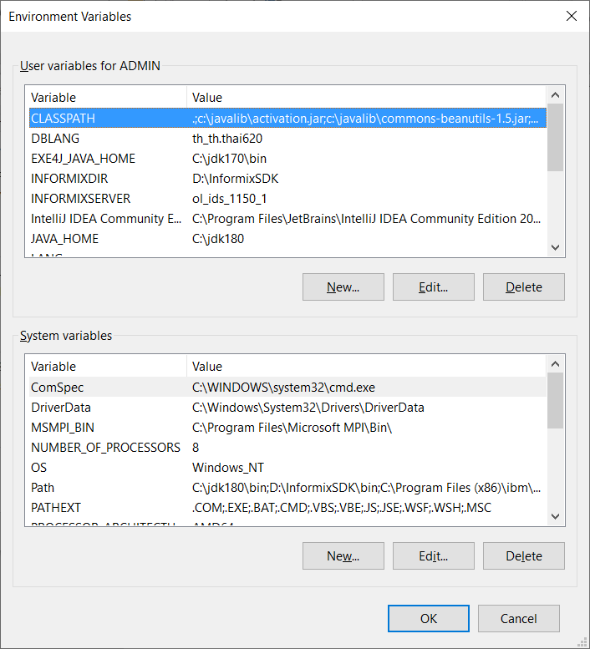
Servlet
Compile Servlet
set CLASSPATH with servlet API
set CLASSPATH=.;C:\apache-tomcat-9.0.71\lib\servlet-api.jar;
set environment variables

Slide 14
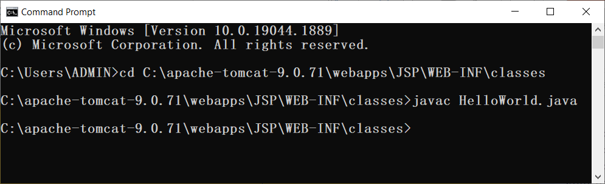
Servlet
Compile Servlet
compile java class

Slide 15
Servlet
Config Servlet
WEB-INF/web.xml
<servlet>
<servlet-name>HelloWorld</servlet-name>
<servlet-class>HelloWorld</servlet-class>
</servlet>
<servlet-mapping>
<servlet-name>HelloWorld</servlet-name>
<url-pattern>/servlet/HelloWorld</url-pattern>
</servlet-mapping>

Slide 16
Servlet
Running Servlet
set JAVA_HOME environment variable
set JAVA_HOME=c:\jdk180
start tomcat
cd C:\apache-tomcat-9.0.71\bin
startup

Slide 17
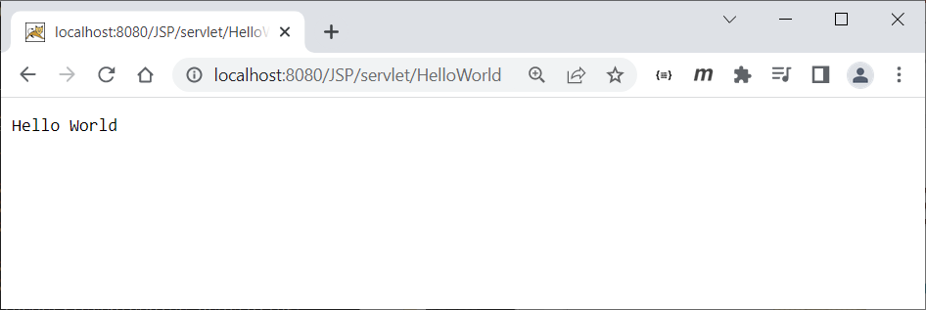
Servlet
Running Servlet
access browser go to http://localhost:8080/JSP/servlet/HelloWorld

Slide 18
Servlet
Reading Parameters
import java.io.*;
import javax.servlet.*;
import javax.servlet.http.*;
public class ReadParam extends HttpServlet {
public void doGet(HttpServletRequest request,HttpServletResponse response)
throws ServletException, IOException {
response.setContentType("text/html");
PrintWriter out = response.getWriter();
out.println("<HTML>");
out.println("<TITLE>Read Param</TITLE>");
out.println("<HEAD></HEAD>");
out.println("<BODY><UL>");
out.println("<LI>"+request.getParameter("id"));
out.println("<LI>"+request.getParameter("name"));
out.println("<LI>"+request.getParameter("surname"));
out.println("</UL></BODY>");
out.println("</HTML>");
}
public void doPost(HttpServletRequest request,HttpServletResponse response)
throws ServletException, IOException {
doGet(request, response);
}
}

Slide 19
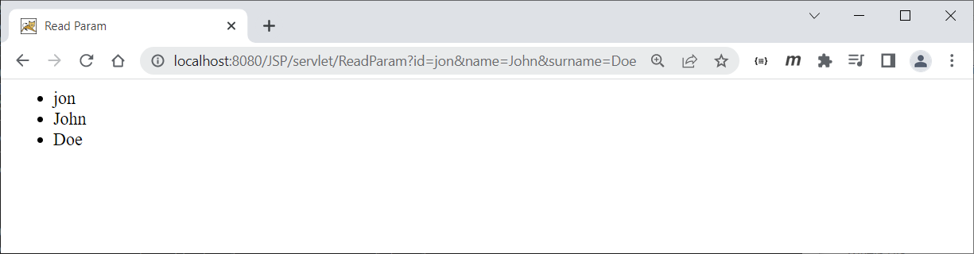
Servlet
Reading Parameters
http://localhost:8080/JSP/servlet/ReadParam?id=jon&name=John&surname=Doe

Slide 20
Servlet
Listing Data Form - I
import java.io.*;
import javax.servlet.*;
import javax.servlet.http.*;
import java.util.*;
public class ListingParam extends HttpServlet {
public void doGet(HttpServletRequest request,HttpServletResponse response)
throws ServletException, IOException {
response.setContentType("text/html");
PrintWriter out = response.getWriter();
out.println("<HTML>");
out.println("<TITLE>Listing Param</TITLE>");
out.println("<HEAD></HEAD>");
out.println("<TABLE BORDER=1 ALIGN=CENTER>");
out.println("<TR><TH>Parameter Name</TH><TH>Parameter Value(s)</TH></TR>");

Slide 21
Servlet
Listing Data Form - II
Enumeration paramNames = request.getParameterNames();
for(;paramNames.hasMoreElements();) {
String paramName = (String)paramNames.nextElement();
out.println("<TR><TD>" + paramName + "<TD>");
String[] paramValues = request.getParameterValues(paramName);
if (paramValues.length == 1) {
String paramValue = paramValues[0];
if (paramValue.length() == 0) out.print("<I>No Value</I>");
else out.print(paramValue);
} else {
out.println("<UL>");
for(int i=0; i<paramValues.length; i++) {
out.println("<LI>" + paramValues[i]);
}
out.println("</UL>");
}
}
out.println("</TABLE></BODY></HTML>");
}
public void doPost(HttpServletRequest request,HttpServletResponse response)
throws ServletException, IOException {
doGet(request, response);
}
}

Slide 22
Servlet
Listing Data Form – SimpleForm.html
<HTML>
<HEAD><TITLE>Simple FORM</TITLE></HEAD>
<BODY>
<FORM ACTION="servlet/ListingParam" METHOD="POST">
Name: <INPUT TYPE="TEXT" NAME="name"></INPUT><BR>
Surname: <INPUT TYPE="TEXT" NAME="surname"></INPUT><BR>
Gender: <INPUT TYPE="RADIO" NAME="gender" VALUE="Male" checked>Male</INPUT>
<INPUT TYPE="RADIO" NAME="gender" VALUE="Male">Female</INPUT>
<INPUT TYPE="RADIO" NAME="gender" VALUE="Other">Other</INPUT><BR>
License : <INPUT TYPE="CHECKBOX" NAME="car" VALUE="permit">Car</INPUT>
<INPUT TYPE="CHECKBOX" NAME="motorcycle" VALUE="permit">Motor Cycle</INPUT><BR>
Birth Date: <SELECT NAME="birthdate">
<OPTION value="sunday">Sunday</OPTION>
<OPTION value="monday" selected>Monday</OPTION>
<OPTION value="tuesday">Tuesday</OPTION>
<OPTION value="wednesday">Wednesday</OPTION>
<OPTION value="thursday">Thursday</OPTION>
<OPTION value="friday">Friday</OPTION>
<OPTION value="saturday">Saturday</OPTION>
</SELECT><BR>
Possesion: <SELECT NAME="possesion" MULTIPLE="TRUE">
<OPTION value="watch" selected>Watch</OPTION>
<OPTION value="mobile" selected>Mobile Phone</OPTION>
<OPTION value="smartphone">Smart Phone</OPTION>
<OPTION value="tablet">Tablet</OPTION>
<OPTION value="notebook">Note Book</OPTION>
</SELECT><BR>
Remark: <TEXTAREA NAME="remark" ROWS=3 COLS=40></TEXTAREA><BR>
<CENTER><INPUT TYPE="SUBMIT" VALUE="SUBMIT"></CENTER>
</FORM>
</BODY>
</HTML>

Slide 23
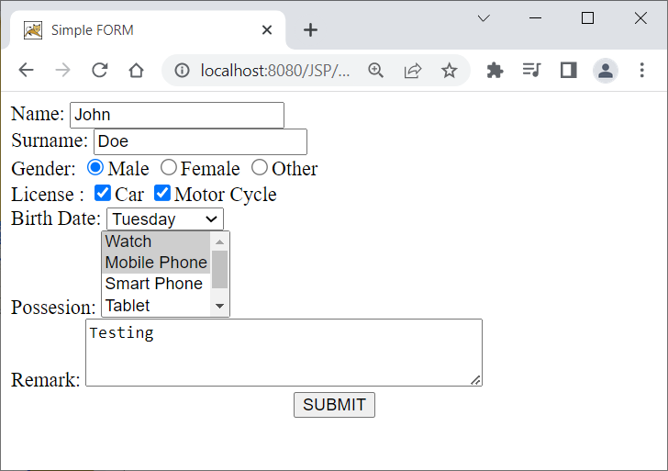
Servlet
Listing Data Form

Slide 24
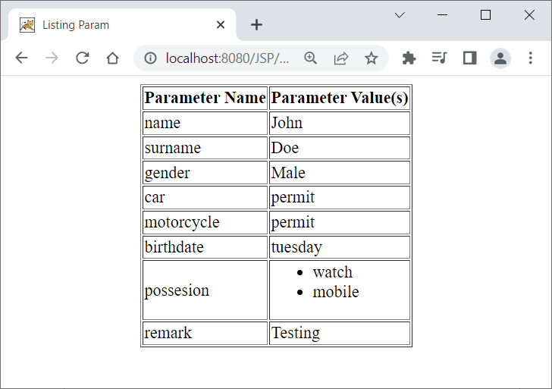
Servlet
Listing Data Form

Slide 25
Servlet
Servlet Container
The main function of the container is to load, initialize and execute servlets
wait for HTTP request
construct a ServletRequest object and a ServletResponse object
load the servlet class and invoke service method, passing the ServletRequest and ServletResponse objects
calls the destroy method and unload when the servlet class is shut down

Slide 26
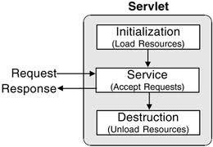
Servlet
Servlet Life Cycle

Slide 27
Servlet
Servlet Life Cycle
public void init(ServletConfig config) throws ServletException
public void service(ServletRequest request, ServletResponse response) throws ServletException, IOException
public void destroy()

Slide 28
Servlet
Servlet Configuration - I
package com.fs.dev;
import javax.servlet.*;
import javax.servlet.http.*;
import java.io.*;
public class TheServlet extends HttpServlet implements java.io.Serializable {
public TheServlet() {
super();
}
public void init(ServletConfig config) throws ServletException {
super.init(config);
System.out.println("-----------------------------------------------------------------");
System.out.println(getClass().getName()+" servlet initialize ...");
System.out.println("------------------------------------------------------------------");
System.out.println("init on "+config.getServletContext().getRealPath(""));
java.util.Enumeration en = config.getInitParameterNames();
for(;en.hasMoreElements();) {
String key = (String)en.nextElement();
System.out.println(key+"="+config.getInitParameter(key));
}
}

Slide 29
Servlet
Servlet Configuration - II
public void service(HttpServletRequest request, HttpServletResponse response) throws ServletException, IOException {
response.setContentType("text/xml; charset=windows-874");
java.util.Enumeration en = request.getParameterNames();
for(;en.hasMoreElements();) {
String key = (String)en.nextElement();
String value = request.getParameter(key);
System.out.println(key+"="+value);
}
String type = request.getParameter("type");
if(type.equals("reset")) {
StringBuffer buf = new StringBuffer();
buf.append("<message type=\"reset\">");
buf.append("<body>ok</body>");
buf.append("</message>");
sendResponse(response,buf.toString());
} else {
StringBuffer buf = new StringBuffer();
buf.append("<message type=\"none\">");
buf.append("<body>Unknown request</body>");
buf.append("</message>");
sendResponse(response,buf.toString());
}
}

Slide 30
Servlet
Servlet Configuration - III
public void destroy() {
System.out.println(this+" destroying.");
}
protected void sendResponse(HttpServletResponse response, String text) {
try {
String header = "";
if(!text.trim().equals("")) header = "<?xml version=\"1.0\" encoding=\"windows-874\"?>";
response.setDateHeader("Expires",System.currentTimeMillis());
response.getOutputStream().println(header+text);
response.getOutputStream().flush();
response.getOutputStream().close();
} catch (Exception ex) {
}
}
}

Slide 31
Servlet
Servlet Configuration – web.xml
<?xml version="1.0" encoding="ISO-8859-1"?>
<!DOCTYPE web-app
PUBLIC "-//Sun Microsystems, Inc.//DTD Web Application 2.3//EN"
"http://java.sun.com/j2ee/dtds/web-app_2_3.dtd">
<web-app>
<servlet>
<servlet-name>TheServlet</servlet-name>
<servlet-class>com.fs.dev.TheServlet</servlet-class>
<init-param>
<param-name>dburl</param-name>
<param-value>jdbc:mysql://127.0.0.1:3306/refdb</param-value>
</init-param>
<init-param>
<param-name>dbuser</param-name>
<param-value>root</param-value>
</init-param>
<init-param>
<param-name>dbpassword</param-name>
<param-value>root</param-value>
</init-param>
<load-on-startup>1</load-on-startup>
</servlet>
<servlet-mapping>
<servlet-name>TheServlet</servlet-name>
<url-pattern>/servlet/TheServlet</url-pattern>
</servlet-mapping>
</web-app>

Slide 32
Servlet
Servlet Life Cycle Events
Object | Event | Listener Interface and Event Class
Web context | Initialization and destruction | javax.servlet.ServletContextListener and ServletContextEvent
 | Attribute added, removed, or replaced | javax.servlet.ServletContextAttributeListener and ServletContextAttributeEvent
Session | Creation, invalidation, activation, passivation, and timeout | javax.servlet.http.HttpSessionListener, javax.servlet.http.HttpSessionActivationListener and HttpSessionEvent
 | Attribute added, removed, or replaced | javax.servlet.http.HttpSessionAttributeListener and HttpSessionBindingEvent
Request | A servlet request has started being processed by web components | javax.servlet.ServletRequestListener and ServletRequestEvent
 | Attribute added, removed, or replaced | javax.servlet.ServletRequestAttributeListener and ServletRequestAttributeEvent

Slide 33
Servlet
Servlet Life Cycle Events
package com.fs.dev;
import javax.servlet.*;
import javax.servlet.http.*;
public class TheSession implements javax.servlet.http.HttpSessionListener {
private static int sessions;
public void sessionCreated(javax.servlet.http.HttpSessionEvent e) {
sessions++;
System.out.println("session created : "+e+", id="+e.getSession().getId());
}
public void sessionDestroyed(javax.servlet.http.HttpSessionEvent e) {
if(sessions>0) sessions--;
System.out.println("session destroyed : "+e+", id="+e.getSession().getId());
java.util.Enumeration en = e.getSession().getAttributeNames();
for(;en.hasMoreElements();) {
Object key = en.nextElement();
System.out.println("destroy("+e.getSession().getId()+") "+key+"="+e.getSession().getAttribute(key.toString()));
}
}
}

Slide 34
Servlet
Servlet Life Cycle Events – web.xml
<?xml version="1.0" encoding="ISO-8859-1"?>
<!DOCTYPE web-app
PUBLIC "-//Sun Microsystems, Inc.//DTD Web Application 2.3//EN"
"http://java.sun.com/j2ee/dtds/web-app_2_3.dtd">
<web-app>
<listener>
<listener-class>com.fs.dev.TheSession</listener-class>
</listener>
</web-app>

Slide 35
Servlet
Servlet Context
An abstraction and mapping to the document root of web application and the resources.
Allow to get/set and change web application scope attribute values.

Slide 36
Servlet
Servlet Context
javax.servlet.ServletContext
ServletContext context = getServletContext();
ServletContext context = request.getSession().getServletContext();
context.setAttribute("someValue", "aValue");
Object attribute = context.getAttribute("someValue");
context.getRealPath("")
RequestDispatcher dispatcher = context.getRequestDispatcher("/index.html");
dispatcher.forward(request,response);

Slide 37
Servlet
Cookies
A cookie is a piece of data stored by a website within a browser and then subsequently sent back to the same website by the browser.
Cookies are usually limited to 4096 bytes
At least 20 cookies per unique host or domain name

Slide 38
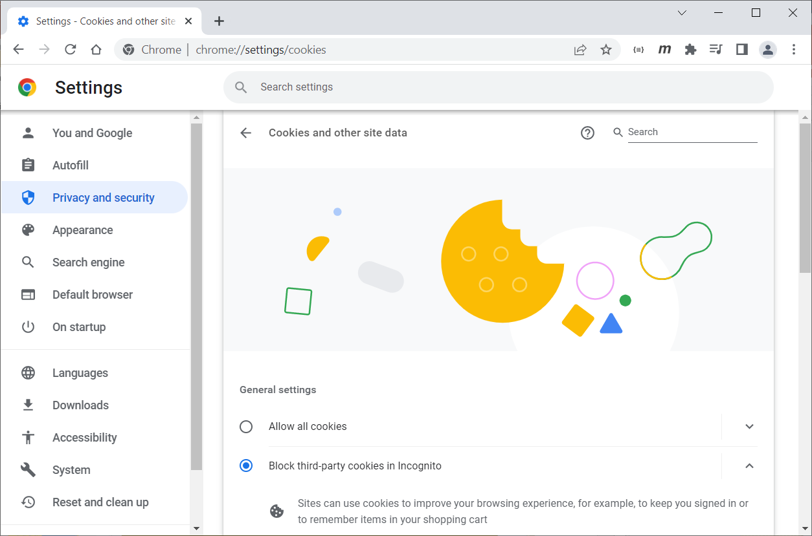
Servlet
Enable Cookies
Chrome

Slide 39
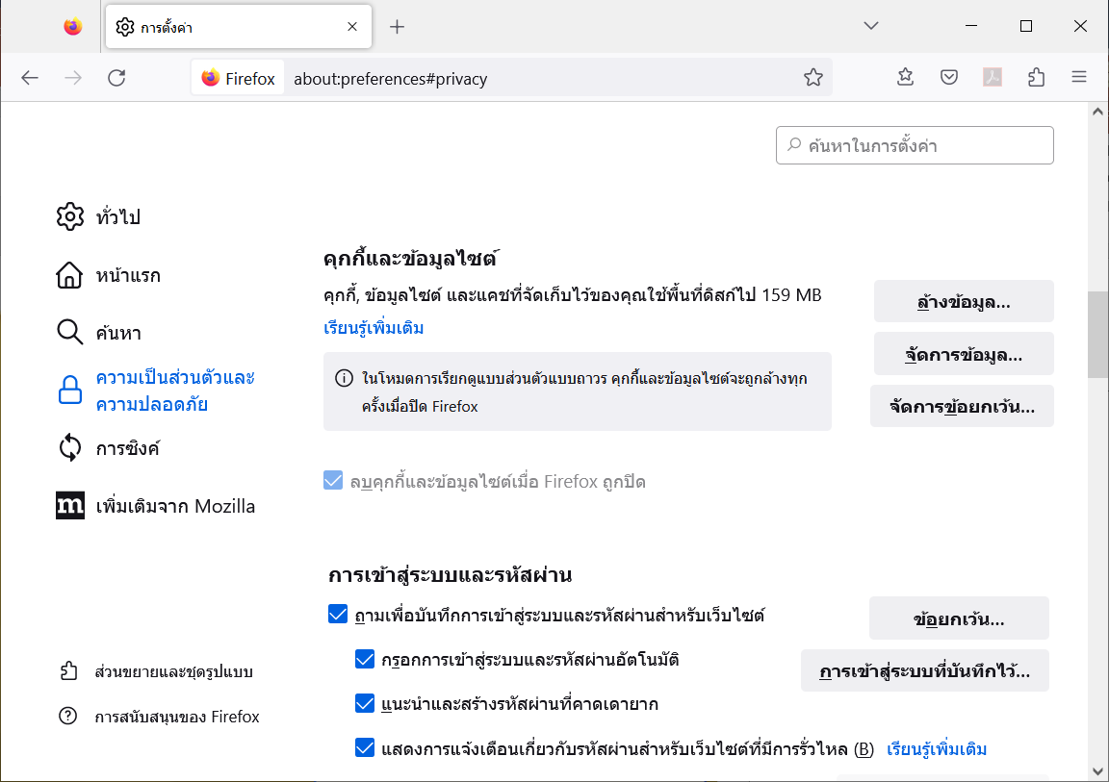
Servlet
Enable Cookies
Firefox

Slide 40
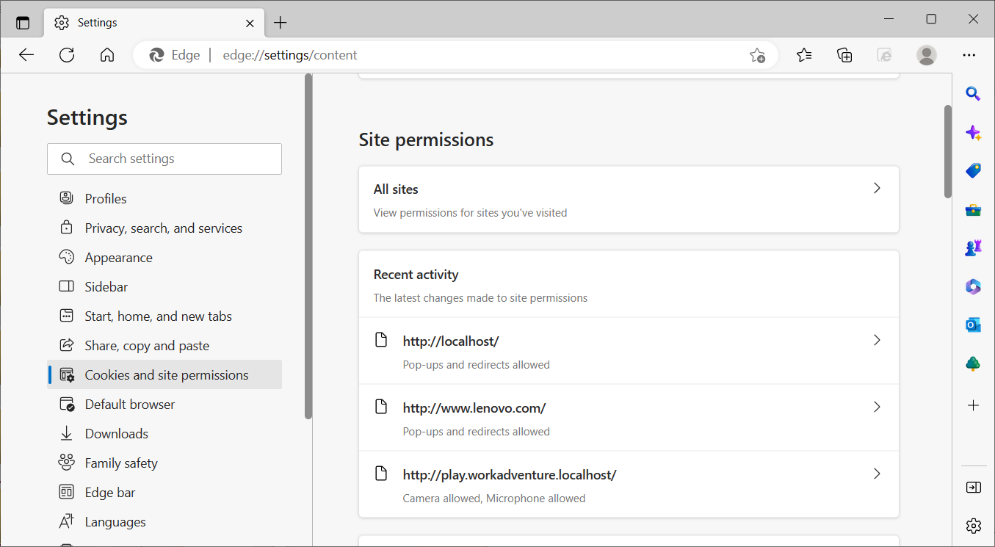
Servlet
Enable Cookies
Edge

Slide 41
Servlet
Cookie Attributes
getComment/setComment
getDomain/setDomain
getMaxAge/setMaxAge
getName/setName
getPath/setPath
getSecure/setSecure
getValue/setValue
getVersion/setVersion

Slide 42
Servlet
Cookies
import java.io.*;
import javax.servlet.*;
import javax.servlet.http.*;
public class CounterCookie extends HttpServlet {
public void doGet(HttpServletRequest request, HttpServletResponse response)
throws ServletException, IOException {
PrintWriter out = response.getWriter();
out.println("Listing Cookies");
int counter = 0;
Cookie[] cookies = request.getCookies();
if(cookies!=null) {
for(int i=0; i<cookies.length; i++) {
Cookie cookie = cookies[i];
out.println(cookie.getName()+" = "+cookie.getValue());
if("counter".equals(cookie.getName())) {
if(cookie.getValue()!=null) {
counter = Integer.parseInt(cookie.getValue());
}
}
}
}
Cookie cookie = new Cookie("counter", ""+(++counter));
response.addCookie(cookie);
}
}

Slide 43
Servlet
Session Tracking
3 Type Problem
Cookie
URL Rewriting
Hidden Form Field
Session Tracking API
HttpSession

Slide 44
Servlet
Session Tracking
import java.io.*;
import javax.servlet.*;
import javax.servlet.http.*;
public class CounterSession extends HttpServlet {
public void doGet(HttpServletRequest request,HttpServletResponse response)
throws ServletException, IOException {
HttpSession session = request.getSession(true);
PrintWriter out = response.getWriter();
Integer counter = new Integer(0);
String heading = "";
if (session.isNew()) {
heading = "Welcome, Newcomer";
} else {
heading = "Welcome Back";
Integer oldCounter = (Integer)session.getAttribute("counter");
if(oldCounter!=null) {
counter = new Integer(oldCounter.intValue() + 1);
}
}
session.setAttribute("counter", counter);
out.println(heading);
out.println("Session ID = "+session.getId());
out.println("Number of Access = "+counter);
}
}

Slide 45
Servlet
Servlet & JDBC - I
import java.io.*;
import javax.servlet.*;
import javax.servlet.http.*;
public class QueryServlet extends HttpServlet {
public void doPost(HttpServletRequest request,HttpServletResponse response)
throws ServletException, IOException {
doGet(request, response);
}
public void doGet(HttpServletRequest request, HttpServletResponse response)
throws ServletException, IOException {
PrintWriter out = response.getWriter();
out.println("<html><head><title>Query</title></head><body>");
out.println(createForm());
String sql = request.getParameter("sql");
System.out.println("sql : "+sql);
if(sql!=null && !sql.trim().equals("")) {
try {
String driver = "com.mysql.jdbc.Driver";
String url = "jdbc:mysql://127.0.0.1:3306/mydb";
String user = "root";
String password = "root";
Class.forName(driver);

Slide 46
Servlet
Servlet & JDBC - II
java.sql.Connection conn = java.sql.DriverManager.getConnection(url,user,password);
java.sql.Statement stm = conn.createStatement();
java.sql.ResultSet rs = stm.executeQuery(sql);
java.sql.ResultSetMetaData met = rs.getMetaData();
out.println("<table border=1>");
out.println("<tr>");
for(int i=1,isz=met.getColumnCount();i<=isz;i++) {
String colname = met.getColumnName(i);
out.println("<th>"+colname+"</th>");
}
out.println("</tr>");
while(rs.next()) {
out.println("<tr>");
for(int i=1,isz=met.getColumnCount();i<=isz;i++) {
String colname = met.getColumnName(i);
out.println("<td>"+rs.getString(colname)+"</td>");
}
out.println("</tr>");
}
out.println("</table>");
} catch(Exception ex) { ex.printStackTrace(); }
}
}
out.print("</body></html>");

Slide 47
Servlet
Servlet & JDBC - III
private String createForm() {
StringBuilder buf = new StringBuilder();
buf.append("<form name=\"qform\" action=\"QueryServlet\" method=\"post\">");
buf.append("<table>");
buf.append("<tr><td>SQL</td><td><input name=\"sql\" size=\"30\"></input></td></tr>");
buf.append("<tr><td></td><td><input type=submit name=\"submit\" value=\"Execute\"></input></tr>");
buf.append("</table>");
buf.append("</form>");
return buf.toString();
}
}

Slide 48
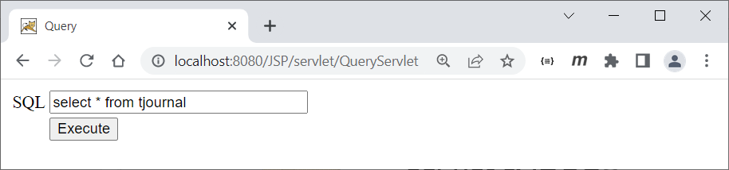
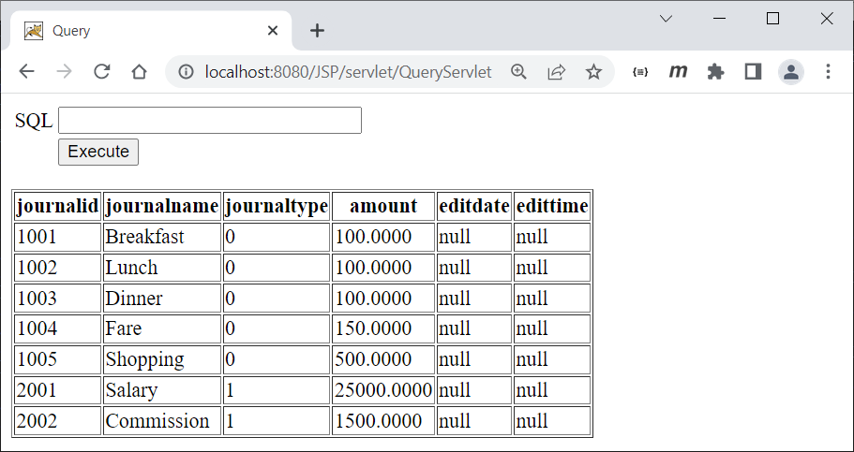
Servlet
Servlet & JDBC
http://localhost:8080/JSP/servlet/QueryServlet

Slide 49
JSP

Slide 50
JSP
What is JSP?
JSP stands for Java Server Page is a technology from Sun that enables the java programmers to generate HTML, XML or other types of documents to server the web client
Allow the programmers to embed Java code into html (.jsp) page

Slide 51
JSP
Advantage of JSP
JSP translate and compile into java servlet but easier to develop
JSP uses simplified scripting language based syntax for embedding HTML
JSP containers provide easy way for accessing standard objects and actions
JSP use HTTP as default request / response communication paradigm

Slide 52
JSP
hello.jsp
<%
String hello = "Hello World";
%>
<html>
<head>
<title>Hello JSP</title>
</head>
<body>
<%=hello%>
</body>
</html>

Slide 53
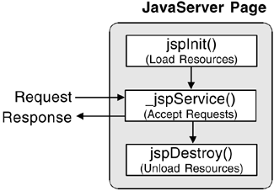
JSP
JSP Lifecycle
jspInit
Invoked one time
jspService
Request and Response
jspDestroy
When shutdown

Slide 54
JSP
JSP Lifecycle
cycle.jsp
<%!
public void jspInit() {
System.out.println(getClass().getName()+" jsp init ...");
}
public void jspDestroy() {
System.out.println(getClass().getName()+" jsp destroy ...");
}
%>
<%
String hello = "Hello World";
System.out.println(hello);
%>
<html>
<head>
<title>Hello JSP</title>
</head>
<body>
<%=hello%>
</body>
</html>

Slide 55
JSP
Java Server Page
Call Java code directly.
Place all Java code in JSP page. Appropriate only for very small amounts of code.
Call Java code indirectly.
Develop separate utility classes. Insert into JSP page only the Java code needed to invoke the utility classes.

Slide 56
JSP
Java Server Page
Use beans
Develop separate utility classes structured as beans. Use jsp:useBean, jsp:getProperty, and jsp:setProperty to invoke the code.
Use the MVC architecture
Have a servlet respond to original request, look up data, and store results in beans. Forward to a JSP page to present results. JSP page uses beans.

Slide 57
JSP
Predefined Variables
request
The HttpServletRequest (1st argument to service/doGet)
response
The HttpServletResponse (2nd arg to service/doGet)
out
The Writer (a buffered version of type JspWriter) used to the client

Slide 58
JSP
Predefined Variables
session
The HttpSession associated with the request (unless disabled with the session attribute of the page directive)
application
The ServletContext (for sharing data) as obtained via getServletContext().

Slide 59
JSP
Predefined Variables
config
This is the ServletConfig object for this page.
page
This is simply a synonym for this.
pageContext
A new class called PageContext to encapsulate use of server-specific features like higher performance JspWriter

Slide 60
JSP
Predefined Variables
index.jsp
<%
String hello = "Hello JSP";
String who = request.getParameter("who");
if(who!=null) hello = "Hello "+who;
%>
<html>
<head>
<title>JSP Examples</title>
</head>
<body bgcolor="#FFFFFF">
<% out.print(hello); %>
</body>
</html>

Slide 61
JSP
Expressions
Format
<%= Java Expression %>
Result
Expression evaluated, converted to String, and placed into HTML page at the place it occurred in JSP page That is, expression placed in _jspService inside out.print
Examples
Current time: <%= new java.util.Date() %>
Your hostname: <%=request.getRemoteHost() %>

Slide 62
JSP
Scriptlets
Format
<% Java Code %>
Result
Code is inserted verbatim into servlet's _jspService
Example
<%String queryData = request.getQueryString(); out.println("Attached GET data: " + queryData); %>
<% response.setContentType("text/plain"); %>

Slide 63
JSP
Declarations
Format
<%! Java Code %>
Result
Code is inserted verbatim into servlet's class definition,outside of any existing methods
Examples
<%! private int someField = 5; %>
<%! private void someMethod(...) {...} %>

Slide 64
JSP
Directives
<%@ page info="SCCS id: $Id$"%>
<%@ page errorPage="errorpage.jsp"%>
<%@ page isErrorPage="true"%>
<%@ page contentType="text/html; charset=windows-874"%>
<%@ page import="java.util.*"%>
<%@ page buffer="none"%>

Slide 65
JSP
Directives
<%@ page autoFlush="true"%>
<%@ page isThreadSafe="true"%>
<%@ page session="false"%>
<%@ page extends="com.fs.bean.SuperJSP"%>
<%@ include file="includefile.jsp"%>

Slide 66
JSP
Directives
errorpage.jsp
<%@ page isErrorPage="true" %>
<html>
<title>Error</title>
<head>
</head>
<body>
<br>
<center>
<a href="javascript:window.history.back();">Go Back</a>
</center>
<br>
<div style="text-align:center;">
<%=exception%>
</div>
<br>
</body>
</html>

Slide 67
JSP
Directives
error.jsp
<%@ page errorPage="errorpage.jsp"%>
<%
String hello = null;
%>
<html>
<head>
<title>Error JSP</title>
</head>
<body>
<%=hello.equals("Hello World")%>
</body>
</html>

Slide 68
JSP
Directives Purpose
Give high-level information about the servlet that will result from the JSP page
Can control
Which classes are imported
What class the servlet extends
What MIME type is generated
How multithreading is handled
If the servlet participates in sessions
The size and behavior of the output buffer
What page handles unexpected error

Slide 69
JSP
Standard Action Tag
<jsp:forward page="forward.jsp"/>
<jsp:include page="includefile.jsp"/>
<jsp:useBean id="fsUser" scope="session" class="com.fs.bean.UserBean"/>
<jsp:setProperty name="fsUser" property="*"/>

Slide 70
JSP
Standard Action Tag
<jsp:useBean>
scope
page – bean can use within the jsp page
request – bean can use from any jsp page processing the same request.
session – bean can use from any jsp page in the same session.
application – bean can use from any jsp page in the same application

Slide 71
JSP
Standard Action Tag
UserBean.java - I
package com.fs.bean;
public class UserBean
{
private String id = null;
private String name = null;
private String surname = null;
public UserBean() {
}
public void setId(String id) {
this.id = id;
}
public String getId() {
return id;
}
public void setName(String name) {
this.name = name;
}

Slide 72
JSP
Standard Action Tag
UserBean.java - II
public String getName() {
return name;
}
public void setSurname(String surname) {
this.surname = surname;
}
public String getSurname() {
return surname;
}
public String toString() {
return super.toString()+"{"+id+","+name+","+surname+"}";
}
}

Slide 73
JSP
Standard Action Tag
user.jsp
<jsp:useBean id="fsUser" scope="session" class="com.fs.bean.UserBean"/>
<jsp:setProperty name="fsUser" property="*"/>
<%
System.out.println(fsUser);
%>
<html>
<head>
<title>JSP Examples</title>
</head>
<body bgcolor="#FFFFFF">
<form name="fsform" action="user.jsp" method="post">
<table>
<tr><td>ID</td><td><input name="id" value=""></input></td></tr>
<tr><td>Name</td><td><input name="name" value=""></input></td></tr>
<tr><td>Surname</td><td><input name="surname" value=""></input></td></tr>
<tr><td><input type="submit" value="submit"></input></td><td><input type="reset" value="reset"></input></td></tr>
</table>
<form>
</body>
</html>

Slide 74
JSP
Standard Action Tag
userbean.jsp
<jsp:useBean id="fsUser" scope="session" class="com.fs.bean.UserBean"/>
<jsp:setProperty name="fsUser" property="*"/>
<%
System.out.println(fsUser);
%>
<html>
<head>
<title>JSP Examples</title>
</head>
<body bgcolor="#FFFFFF">
<table>
<tr><td>ID</td><td><jsp:getProperty name="fsUser" property="id"/></td></tr>
<tr><td>Name</td><td><jsp:getProperty name="fsUser" property="name"/></td></tr>
<tr><td>Surname</td><td><jsp:getProperty name="fsUser" property="surname"/></td></tr>
</table>
</body>
</html>

Slide 75
JSP
Standard Action Tag
usersession.jsp
<%
com.fs.bean.UserBean fsUser = (com.fs.bean.UserBean)session.getAttribute("fsUser");
%>
<html>
<head>
<title>JSP Examples</title>
</head>
<body bgcolor="#FFFFFF">
<table>
<tr><td>ID</td><td><%=fsUser.getId()%></td></tr>
<tr><td>Name</td><td><%=fsUser.getName()%></td></tr>
<tr><td>Surname</td><td><%=fsUser.getSurname()%></td></tr>
</table>
</body>
</html>

Slide 76
JSP
Custom Tags
Tag Handler Class
Java code to output
Tag Library Descriptor File
XML file describing tag name, attributes and tag handler class (TLD file)
JSP File
Import tag library
Define tag prefix
Use tag

Slide 77
JSP
Custom Tags
Tag Handler Class (Select.java - I)
package com.fs.tag;
import java.io.*;
import java.util.*;
import javax.servlet.http.*;
import javax.servlet.jsp.*;
import javax.servlet.jsp.tagext.*;
public class Select extends BodyTagSupport {
private String name = null;
private String section = null;
public Select() {
super();
}
public String getName() {
return name;
}
public String getSection() {
return section;
}

Slide 78
JSP
Custom Tags
Tag Handler Class (Select.java - II)
public void setName(String newName) {
name = newName;
}
public void setSection(String section) {
this.section = section;
}
public int doAfterBody() throws JspException {
try {
BodyContent body = getBodyContent();
JspWriter out = body.getEnclosingWriter();
StringBuffer outstr = new StringBuffer();
outstr.append("<select name='");
outstr.append(name);
outstr.append("' ");
outstr.append(">");

Slide 79
JSP
Custom Tags
Tag Handler Class (Select.java - III)
BufferedReader contentReader = new BufferedReader(body.getReader());
String rowread = "";
StringBuffer item = new StringBuffer();
while ((rowread = contentReader.readLine()) != null) {
item.append(rowread.trim());
}
java.util.Map tree = null;
if((getSection()!=null) && !getSection().equals("")) {
tree = (java.util.Map)this.pageContext.getSession().getAttribute(getSection());
}
if((tree!=null) && !tree.isEmpty()) {
java.util.Iterator it = tree.keySet().iterator();
for(;it.hasNext();) {
Object key = it.next();
String value = (String)tree.get(key);
if((key!=null) && (value!=null)) {

Slide 80
JSP
Custom Tags
Tag Handler Class (Select.java - IV)
if(item.toString().equals(key.toString())) {
outstr.append("<option value=\""+key+"\" selected>"+value+"</option>\n");
} else {
outstr.append("<option value=\""+key+"\">"+value+"</option>\n");
}
}
}
}
outstr.append("</select>");
if(outstr!=null){
out.println(outstr.toString());
}
} catch (IOException e) {
throw new JspTagException(e.toString());
}
return SKIP_BODY;
} }

Slide 81
JSP
Custom Tags
Tag Library Descriptor File – taglibs.tld - I
<?xml version="1.0" encoding="UTF-8"?>
<!DOCTYPE taglib PUBLIC "-//Sun Microsystems, Inc.//DTD JSP Tag Library 1.2//EN" "http://java.sun.com/dtd/web-jsptaglibrary_1_2.dtd">
<taglib>
<tlib-version>1.0</tlib-version>
<jsp-version>1.2</jsp-version>
<short-name>input</short-name>
<uri>http://freewillsolutions.com/RD/taglibs/formcontrol</uri>
<description>Set of JSP external Tag from Freewill Solutions. Use for control a entry form.</description>

Slide 82
JSP
Custom Tags
Tag Library Descriptor File – taglibs.tld - II
<tag>
<name>select</name>
<tag-class>com.fs.tag.Select</tag-class>
<body-content>JSP</body-content>
<attribute>
<name>name</name>
<required>true</required>
<rtexprvalue>true</rtexprvalue>
</attribute>
<attribute>
<name>section</name>
<required>false</required>
</attribute>
</tag>
</taglib>

Slide 83
JSP
Custom Tags
tag.jsp - I
<%@ taglib uri="/WEB-INF/taglibs.tld" prefix="fs"%>
<%
java.util.Map map = new java.util.TreeMap();
map.put("01","Male");
map.put("02","Female");
map.put("03","Other");
session.setAttribute("GENDER",map);
%>
<html>
<meta http-equiv="content-type" content="text/html; charset=windows-874">
<title>Test TLD</title>
<head>
</head>
<body>
<fs:select name="gender" section="GENDER">03</fs:select>

Slide 84
JSP
Custom Tags
tag.jsp - II
<select name="gender1">
<%
java.util.Iterator it = map.keySet().iterator();
for(;it.hasNext();) {
String key = (String)it.next();
String value = (String)map.get(key);
%>
<option value="<%=key%>"><%=value%></option>
<%
}
%>
</select>
</body>
</html>

Slide 85
JSP
Custom Tags
Simple Tag File – tomcat 5 or later
helloWorld.jsp
helloWorld.tag
<%@ taglib prefix="tags" tagdir="/WEB-INF/tags" %>
<html>
<head>
<title>Hello World Using Tag File</title>
</head>
<body>
<tags:helloWorld/>
</body>
</html>
<font color=red>Hello, world!</font>

Slide 86
JSP
JSP & JDBC
jdbc.jsp - I
<%@ page errorPage="errorpage.jsp"%>
<%@ page contentType="text/html; charset=windows-874"%>
<%@ page import="com.fs.bean.util.*"%>
<html>
<head>
<title>Query</title>
</head>
<body>
<form name="qform" action="jdbc.jsp" method="post">
<table>
<tr><td>SQL</td><td><input name="sql" size="30"></input></td></tr>
<tr><td></td><td><input type=submit name="submit" value="Execute"></input></tr>
</table>
</form>
<table border=1>

Slide 87
JSP
JSP & JDBC
jdbc.jsp - II
<%
String sql = request.getParameter("sql");
System.out.println("sql : "+sql);
if(sql!=null && !sql.trim().equals("")) {
String driver = "com.mysql.jdbc.Driver";
String url = "jdbc:mysql://127.0.0.1:3306/mydb";
String user = "root";
String password = "root";
Class.forName(driver);
java.sql.Connection conn = java.sql.DriverManager.getConnection(url,user,password);
java.sql.Statement stm = conn.createStatement();
java.sql.ResultSet rs = stm.executeQuery(sql);
java.sql.ResultSetMetaData met = rs.getMetaData();
out.println("<tr>");
for(int i=1,isz=met.getColumnCount();i<=isz;i++) {
String colname = met.getColumnName(i);
out.println("<th>"+colname+"</th>");
}

Slide 88
JSP
JSP & JDBC
jdbc.jsp - III
out.println("</tr>");
while(rs.next()) {
out.println("<tr>");
for(int i=1,isz=met.getColumnCount();i<=isz;i++) {
String colname = met.getColumnName(i);
out.println("<td>"+rs.getString(colname)+"</td>");
}
out.println("</tr>");
}
}
%>
</table>
</body>
</html>

Slide 89
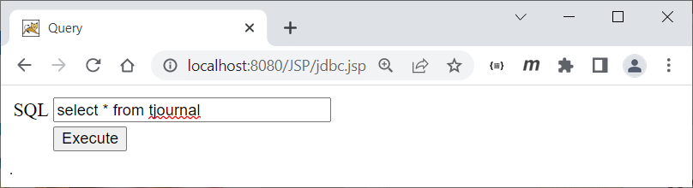
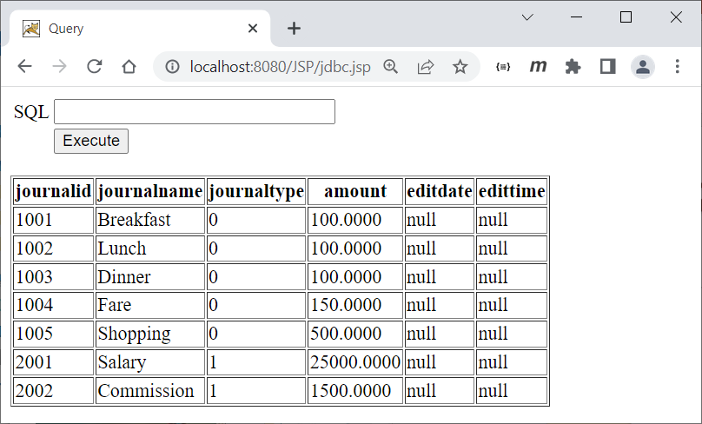
JSP
JSP & JDBC
http://localhost:8080/JSP/jdbc.jsp

Slide 90
Reference
https://www.javatpoint.com/servlet-tutorial
https://www.geeksforgeeks.org/introduction-java-servlets/
https://www.baeldung.com/intro-to-servlets
https://www.tutorialspoint.com/jsp/index.htm
https://www.javatpoint.com/jsp-tutorial
https://www.geeksforgeeks.org/introduction-to-jsp/

Slide 91
Q & A

